Slide 1
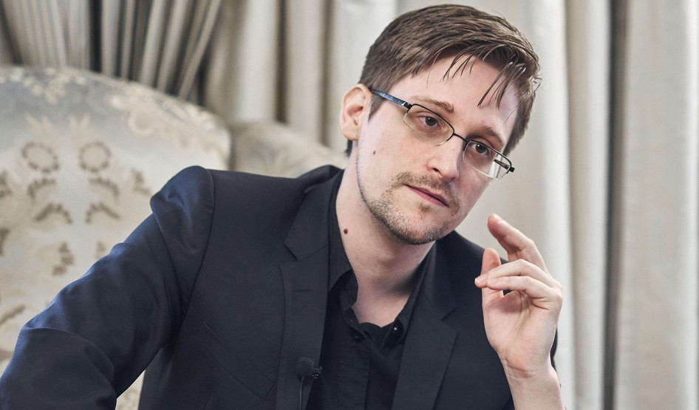
Edward Snowden

Slide 2
BIOGRAPHy
Edward Snowden is an American – technical specialist, former employee The CIA and the National Security Agency (NSA), USA.
Born on June 21, 1983 in the city Elizabeth city, North Carolina.
From may 7 to September 28, 2004 he served in The U.S. armed forces (reservist "special operations Forces"). Left the service after a fracture of both legs during the exercise, not completing the course military training.
Then he worked for the NSA, starting a career in the protection of a secret facility on the University of Maryland, CASL presumably.
After the NSA, he worked in the CIA's information security division, in particular, from March 2007 to February 2009 he worked under the diplomatic The cover of the U.S. permanent mission to the UN (Geneva).
In 2009, Edward retired and started working in consulting companies, working with the NSA, first at Dell, then at the military contractor Booz Allen. Hamilton.

Slide 3
BIOGRAPHy
In early June 2013, Snowden gave Newspapers The Guardian and The Washington Post classified information of the NSA concerning the total surveillance of American intelligence services for information communications between citizens of many countries around the world through existing information networks and communication networks, including information about the PRISM project, as well as X-Keyscore and Tempora.
Snowden stole 1.7 million secret files, most of the documents relate to “vital operations of the US Army, Navy, marine corps and air force”. In this regard, in the United States June 14, 2013 Snowden in absentia were charged with espionage and theft of state property.
In August 1, 2013 he received temporary asylum in Russia, and a year later — a three-year residence permit. Lives in Russia outside Moscow.
In March 2015, he expressed his desire to leave Russia and move to Switzerland.

Slide 4
The benefits of Snowden's actions
Alone, Snowden has changed people's attitudes to their phones and tablets and sparked public debate about the protection of personal data. But his revelations have not yet led to the necessary reforms.
The Obama administration has allowed Internet companies to partially disclose information about the content of intelligence requests.
In Snowden's documents there are examples of abuse of authority by the British communications Service, and information about the so-called "Five eyes" system, uniting the US intelligence services, the UK, Canada, Australia and New Zealand.
Canadian law virtually prohibits Internet companies from disclosing information about intelligence requests.

Slide 5
Thx for attention!

